Slide 1

Non-Clinical Services Research Findings
January 5th, 2022

Slide 2
Agenda
1
Research goals
2
Research findings
3
Recommendations & next steps
4
Appendix

Slide 3

Research Goals

Slide 4
Goals
To align benefits and services across VAMC pages, we need to determine how Veterans expect services to be categorized. This study gathered feedback on existing services, existing categories, and for potential new actions identified in facility site audits.

Slide 5
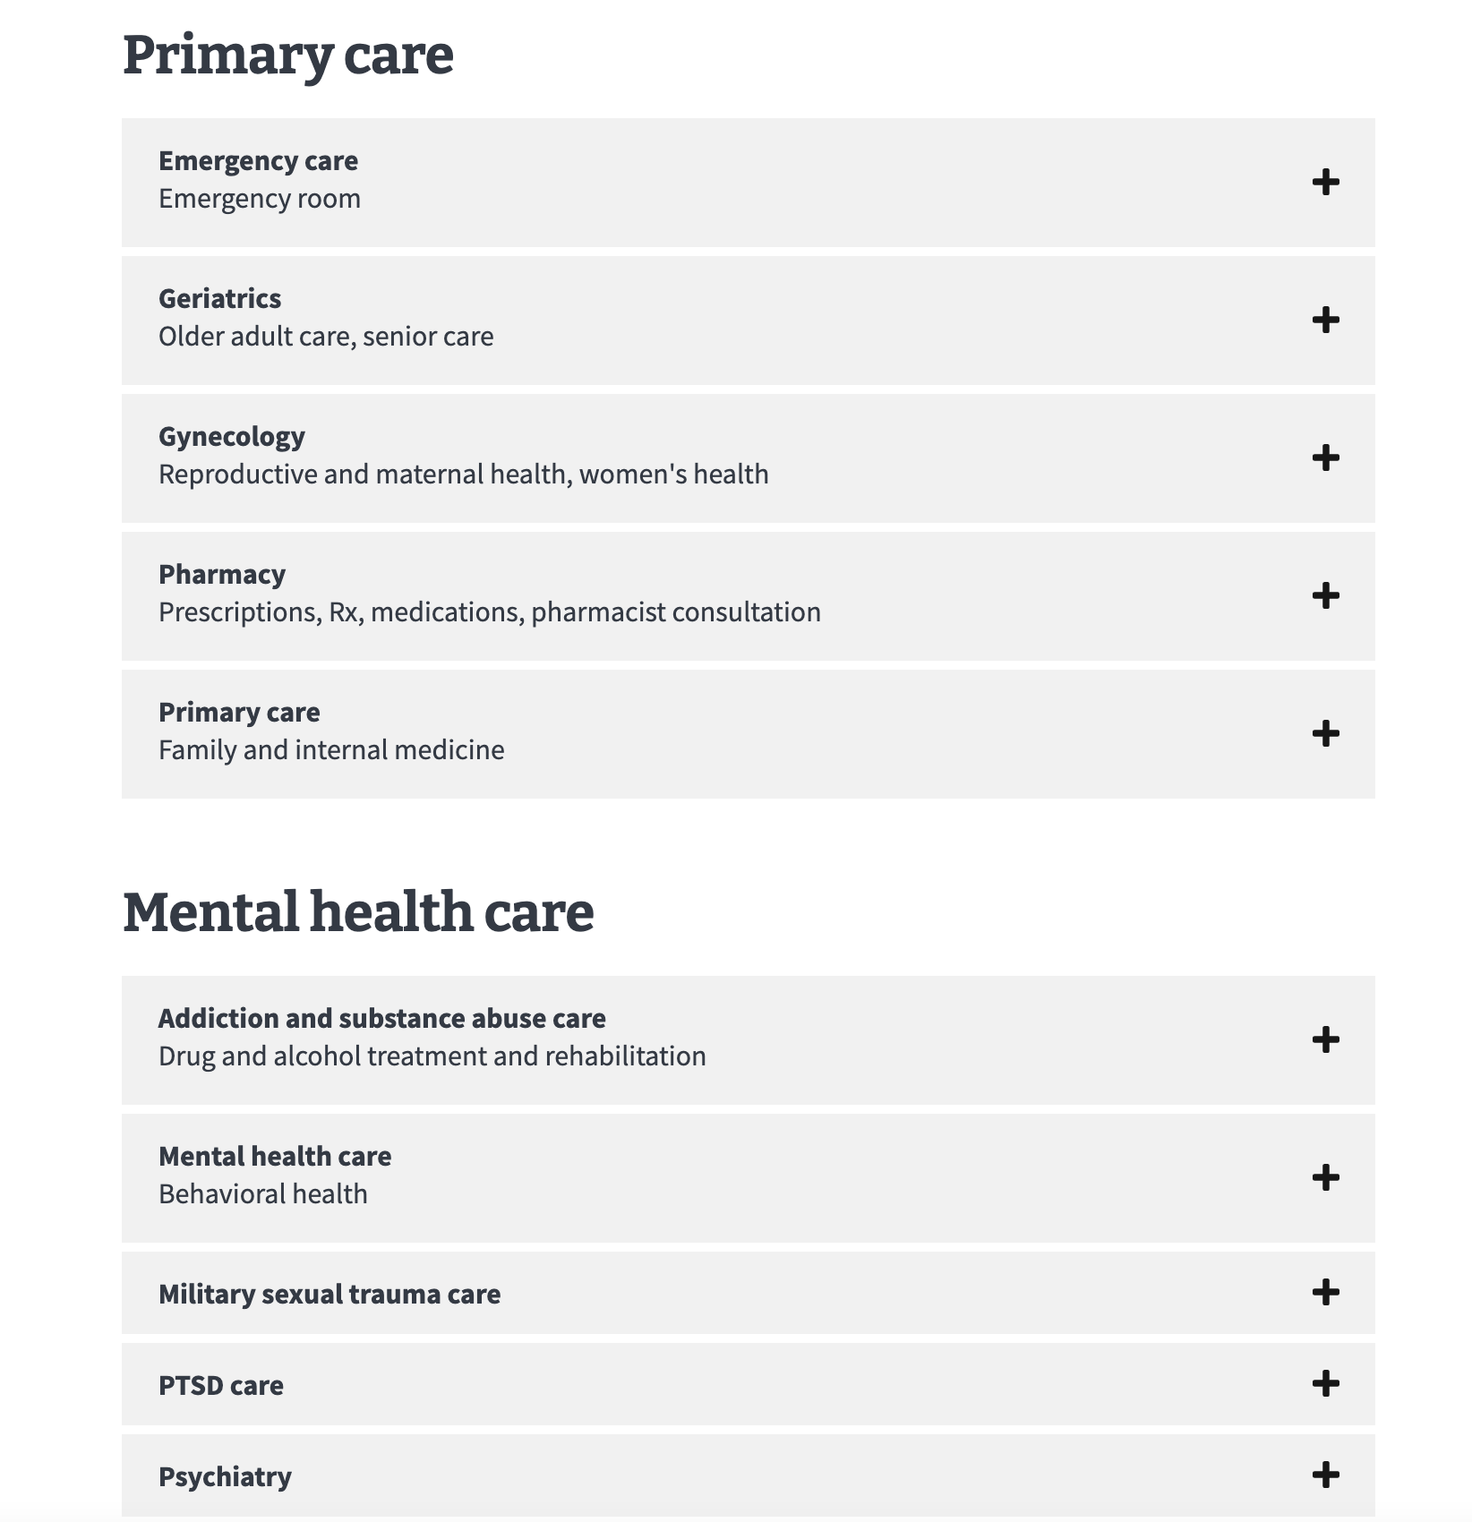
Research: categories
Existing categories
Primary care
Mental health care
Specialty care
Social programs and services
Prepare for your visit
Proposed category
Administrative
New categories
Participants created new categories, or did not, as appropriate.

Slide 6
Research: services
(The complete list of services can be found in the appendix section.)
Existing services included
Women Veteran care
Travel reimbursement
Social work
Registry exams
My HealtheVet Coordinator
Existing Vet Center services
Workshops and classes
Veteran connections
Grief and bereavement counseling
Proposed services included
Chaplain service
Applying for health care
Library services
Medical records
Billing and insurance

Slide 7
Questions & Hypotheses
Questions
Do the existing categories accurately reflect Veteran expectations?
Will Veterans create additional categories for existing services?
Will Veterans create additional categories for new services?
Are there services that are confusing?
Do existing category names cause confusion?
Hypotheses
Veterans will associate most services with existing category headings.
Veterans will create new categories for some of the existing services.
Veterans will create new categories for some of the new services.
Some of the existing, and new, services will cause confusion, and may require plainer language.

Slide 8
Research Findings

Slide 9
Key findings: 1-2 / 6
Most participants found the pre-determined categories adequate.
8 of 14 participants sorted all services into the pre-determined categories
“I think the categories are pretty good you know...[they] are self-explanatory and represent a good group of where I would look for information for specific things.” [P3]
All participants utilized the new "Administrative" category.
14 of 14 participants added services to the "Administrative" category.
“It is registration paperwork, so it belongs in administrative...The distinction is that the admin group is paperwork.” [P2]

Slide 10
Key findings: 3-4 / 6
Some participants suggested new categories for existing services.
6 of 14 participants chose to add existing services to new categories
New categories for existing services:
Onboarding
Incoming Veterans
Transition
Post-service
Almost no participants suggested new categories for new actions.
1 of 14 participants chose to add new actions to two new categories
New categories for new actions:
Substance abuse
Post-service

Slide 11
Key findings: 5 / 6
There were services that needed plainer description, and/or additional explanation.
13 of 14 participants had questions about services
Services requiring more than one explanation:
Registry exams
Veteran connections
Returning service member care
Whole health
Library services
Advice nurse
My HealtheVet Coordinator
Privacy office

Slide 12
Key findings: 6 / 6
How service categorization was distributed across participants:
Per-service breakdown of categories based on confidence level (see appendix)
High confidence
Medium confidence
Unsure / need more information
The "Administrative" category had the most consistent alignment across participants
The most popular categories:
Administrative
Social programs and services
Specialty care
The least popular categories:
Prepare for your visit
Mental health care

Slide 13
Recommendations

Slide 14
Recommendations – 1/3
1
Add the "Administrative" category to system-level and facility-level pages
Every participant utilized the "Administrative" category, making it one of the most popular categories for new and existing services. The general sentiment was that some services seemed obviously administrative because they involved registration, paperwork, and requiring employee help for same.

Slide 15
Recommendations – 2/3
2
Adding relevant patient-friendly name to services requiring explanation
Similar services required explanation across participants, so utilizing the service patient-friendly name design pattern for new and existing services where appropriate, should help Veterans more quickly understand why a service belongs in a particular category.

Slide 16
Recommendations – 3/3
3
Consider creating a category heading that calls out returning Veterans
Of the new categories that were created, the majority were related to leaving active duty service, and returning to civilian life and/or entering the VA health care system. Even though the sample size for this study was relatively small, since multiple participants pointed out the utility this category would have for them, it makes me believe that it is worth considering exploring this additional to facility pages.

Slide 17
Feedback and next steps
Recommendations
Add the “Administrative” category to facility pages
Adding relevant patient-friendly language to service accordions if not present
Consider a new category heading that calls out returning Veterans
Next steps notes
Change management plan
Communications plan
A way to batch requests
List of services with plain language and without

Slide 18
Appendix

Slide 19
Our participants
14 total participants
Gender
Male: 10
Female: 4
Race
Black: 2
White: 11
Native, Black or African American: 1
Location
Urban: 7
Rural: 5
Age
25 – 34: 1
34 – 64: 5
65+: 4
Unknown: 4
Education
High school: 1
Some college: 3
BA: 4
MA: 4
Unknown: 2

Slide 20
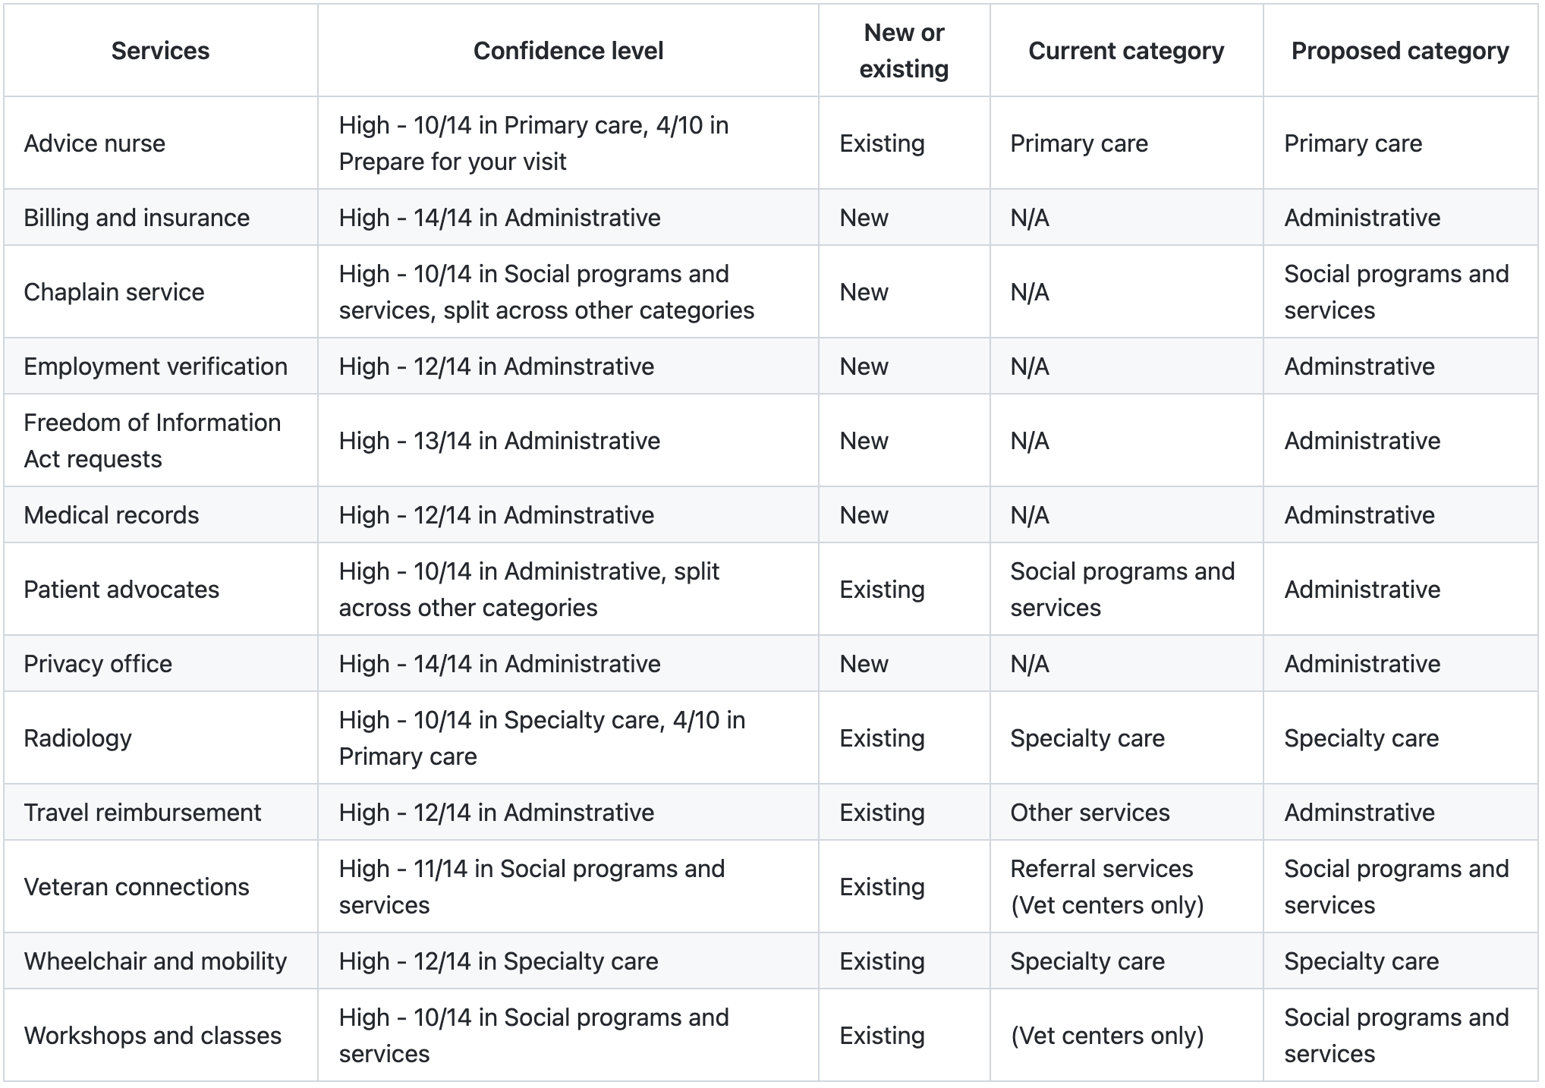


Service categorization - High confidence
Chart Key
No change
Moving
* “split” refers to services being divided into different categories, with low/no alignment across participants
*

Slide 21
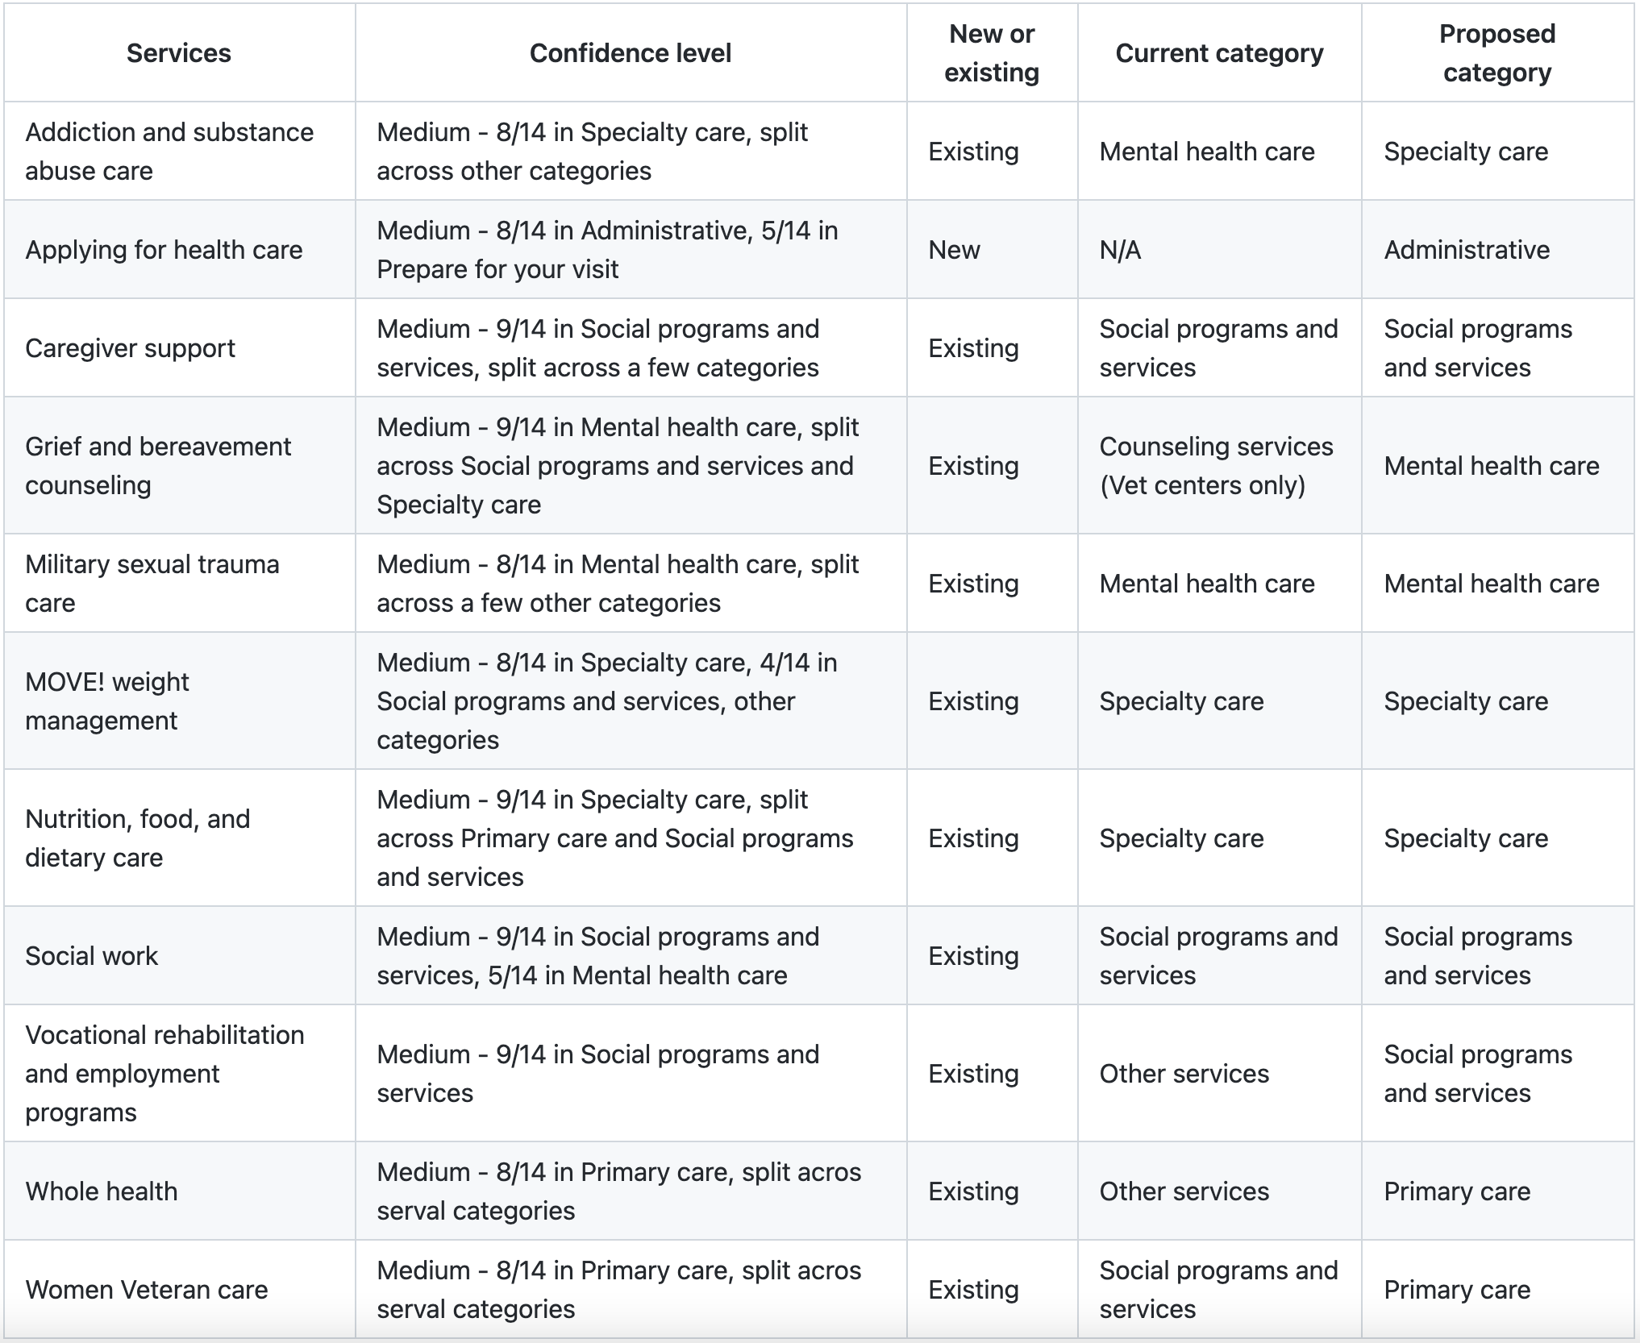
Service categorization - Medium confidence
* 3 / 4 female participants put Women Veteran care in the Primary care category. The 4th put it in Specialty care.
*

Slide 22
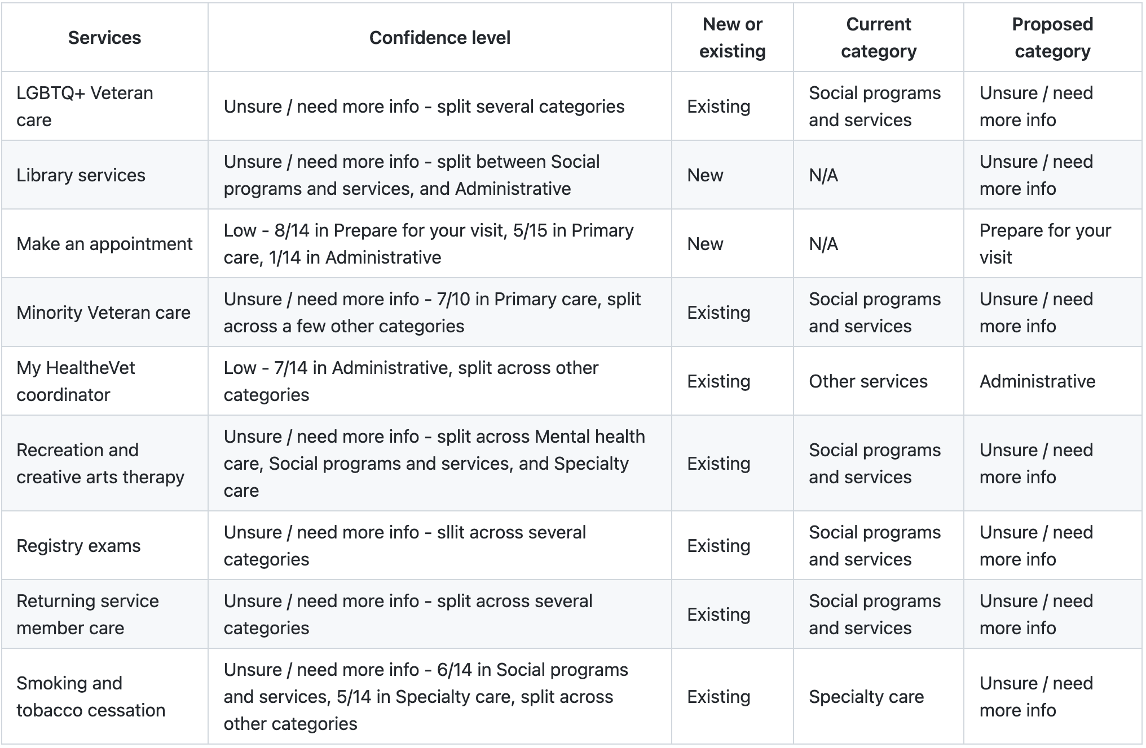

Service categorization – Low confidence / unsure

